Slide 1
Instrument
An Educational Platform to Organize Your Work

Slide 2
Contents
00.
Introduction
02.
Implementation
Problem Statement
Proposed Solution
Programming Languages, Tools, API
Main functionality
Features
02.
Testing
03.
Conclusion and future work
Testing Approach
Testing Tools
Testing Features
Testing Samples
Conclusions
Growth Areas
Notes:
Organized in the same way the documentation is organized

Slide 3
Introduction

Slide 4
Online Educational Industry
1000+
+1.1B
+$199B
+$602B
Platforms
Students (online)
Value Now
Value By 2030
Notes:
Give some numbers on the industry to showcase its importance and that there is an investment in the field we are working on

Slide 5

Problem Statement
00.
01.
Too many platforms and Overwhelming Resource
Issues in Organizing assets, courses, and tasks
Notes:
Provide some examples on the overwhelming resource and platforms
HIgher education and work is a smaller gap than higher education and schools
Low investment due to lack of importance and resources
Public tooling gaps and flaws

Slide 6
Unified educational platform that provides the necessary modern tools to be able to collaborate, organize, and search for knowledge with ease
Mission
Empower learners of all ages to reach their full potential through accessible, engaging, and effective educational experiences
Vision
Notes:
Provide a mission and vision to the platform to underline the proposed solution

Slide 7
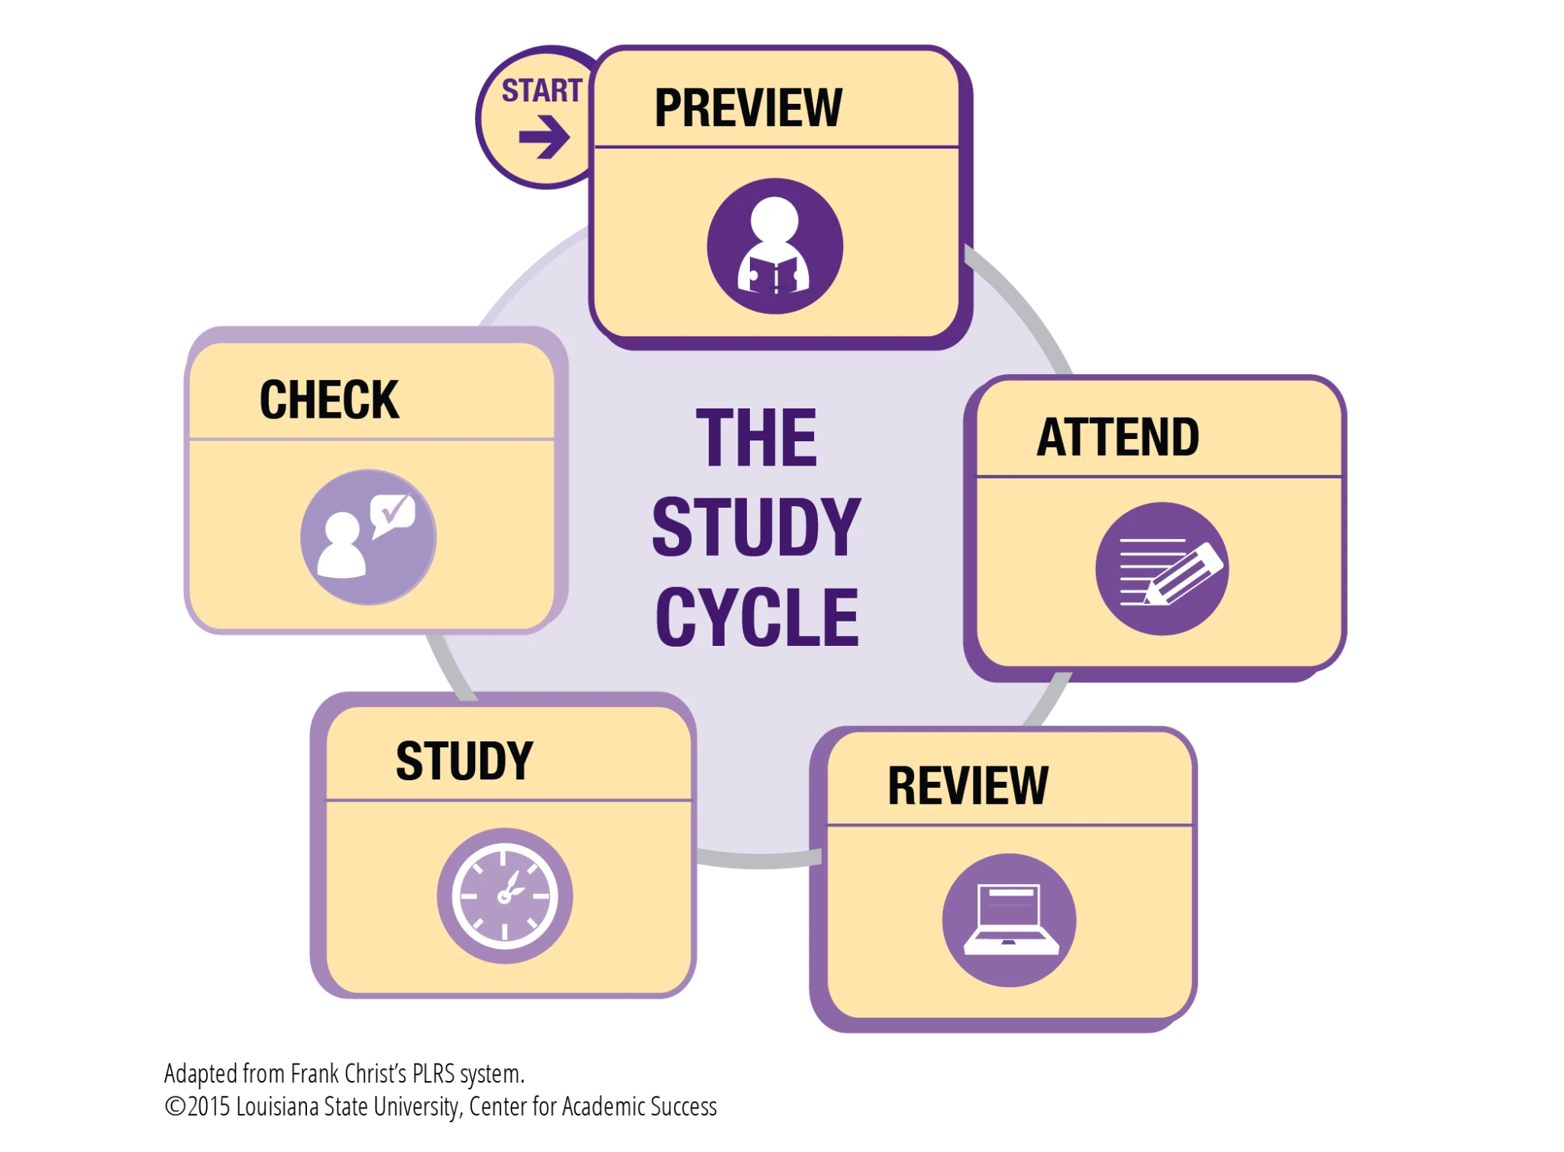

Slide 8



Proposed Solution
Secure, Reliable, and Efficient Unified Platform
Tools for sharing and organizing
Asset Organization Suggestions

Slide 9
Implementation

Slide 10
Programming Languages, Tools, API
00
01
Front-End
Back-End
Notes:
Open source since education should not be a closed off technology it should be for everyone and from everyone
Enterprise platform for fully managed solution

Slide 11



Frontend frameworks
Notes:
Talk about each one in a bit more details and how some of them are stateless

Slide 12


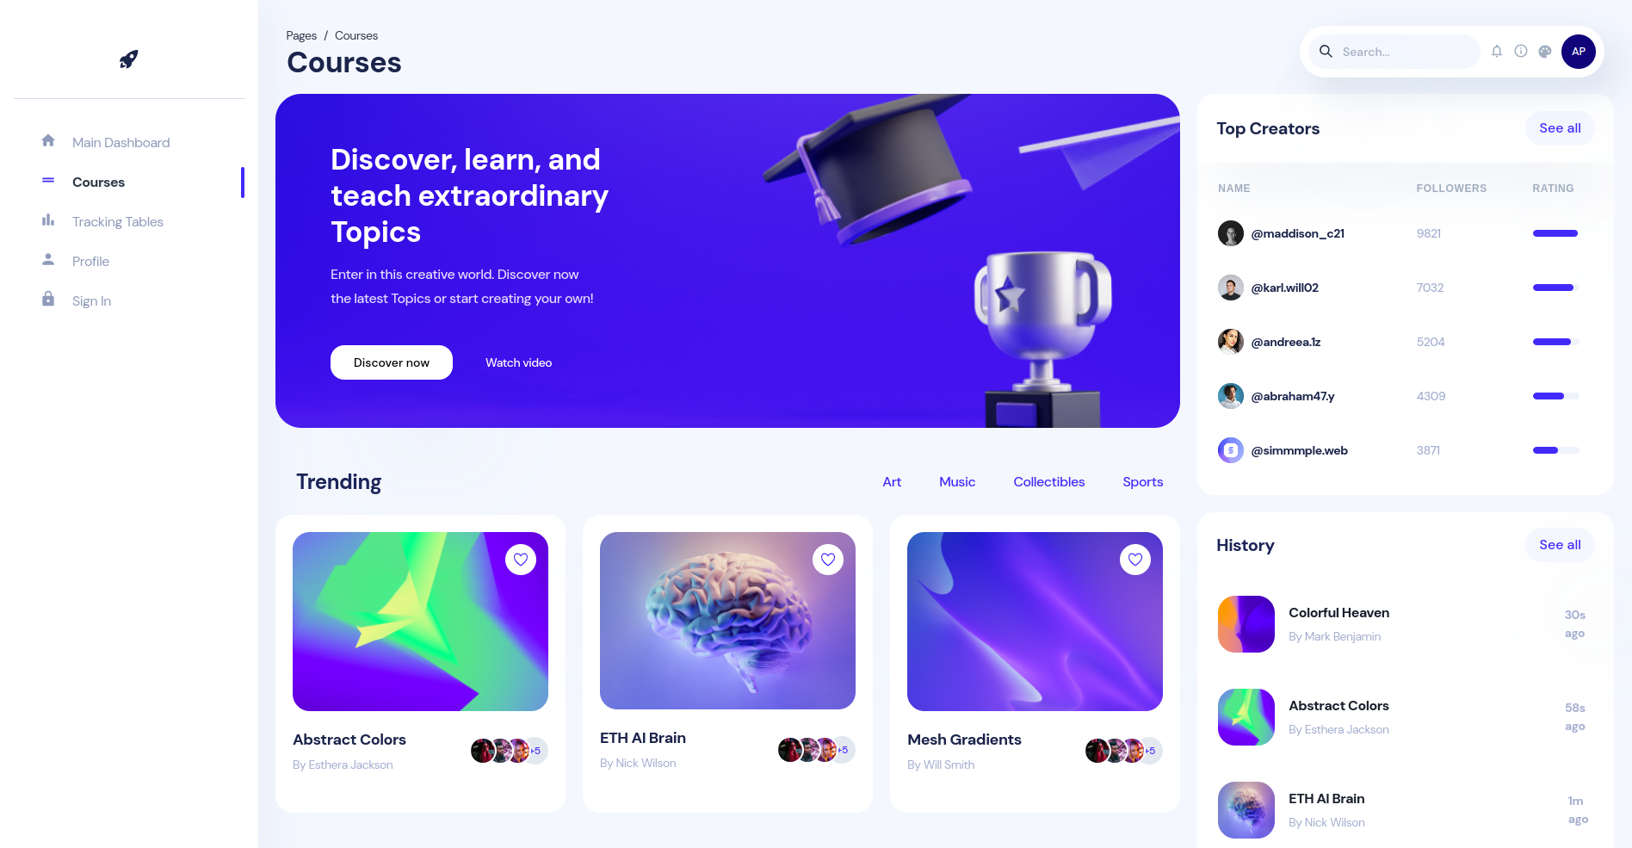
Modern Platform
Build using React
Well-Designed UI with white labeling
Interactive User experience
Notes:
Talk about why the interfaces are different (due to customization for enterprise use and custom courses)

Slide 13
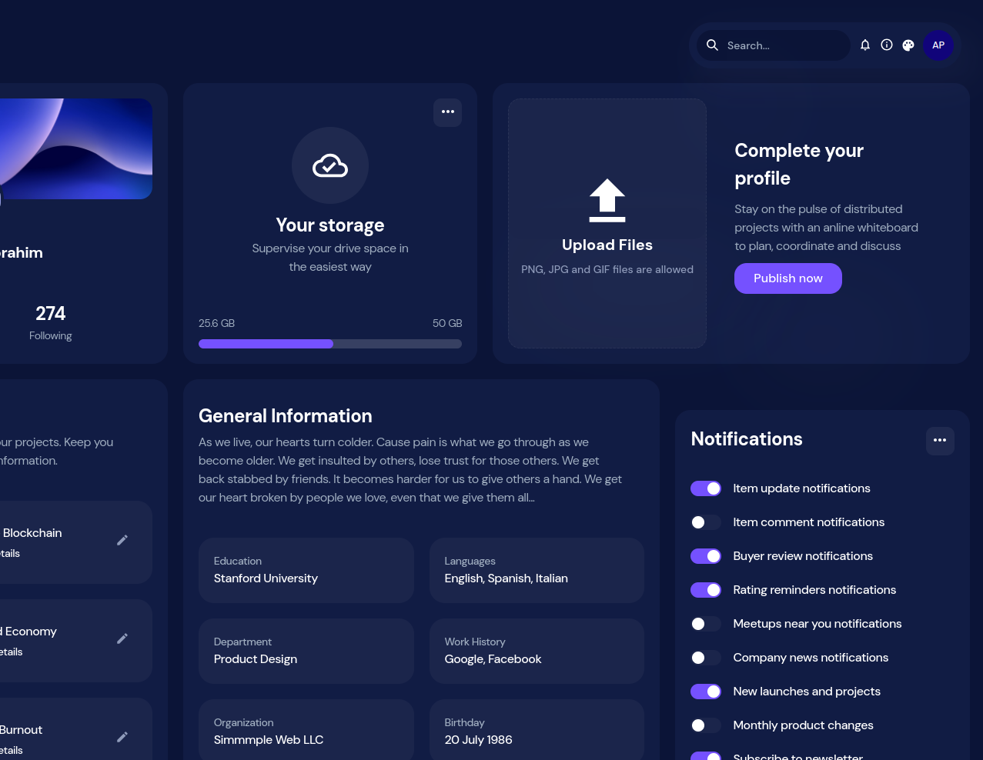

Resources and Asset Management
Upload any type of files (General)
Suggest where the file should be stored (Organization)
Provide a large quota for each user (50 GB)

Slide 14

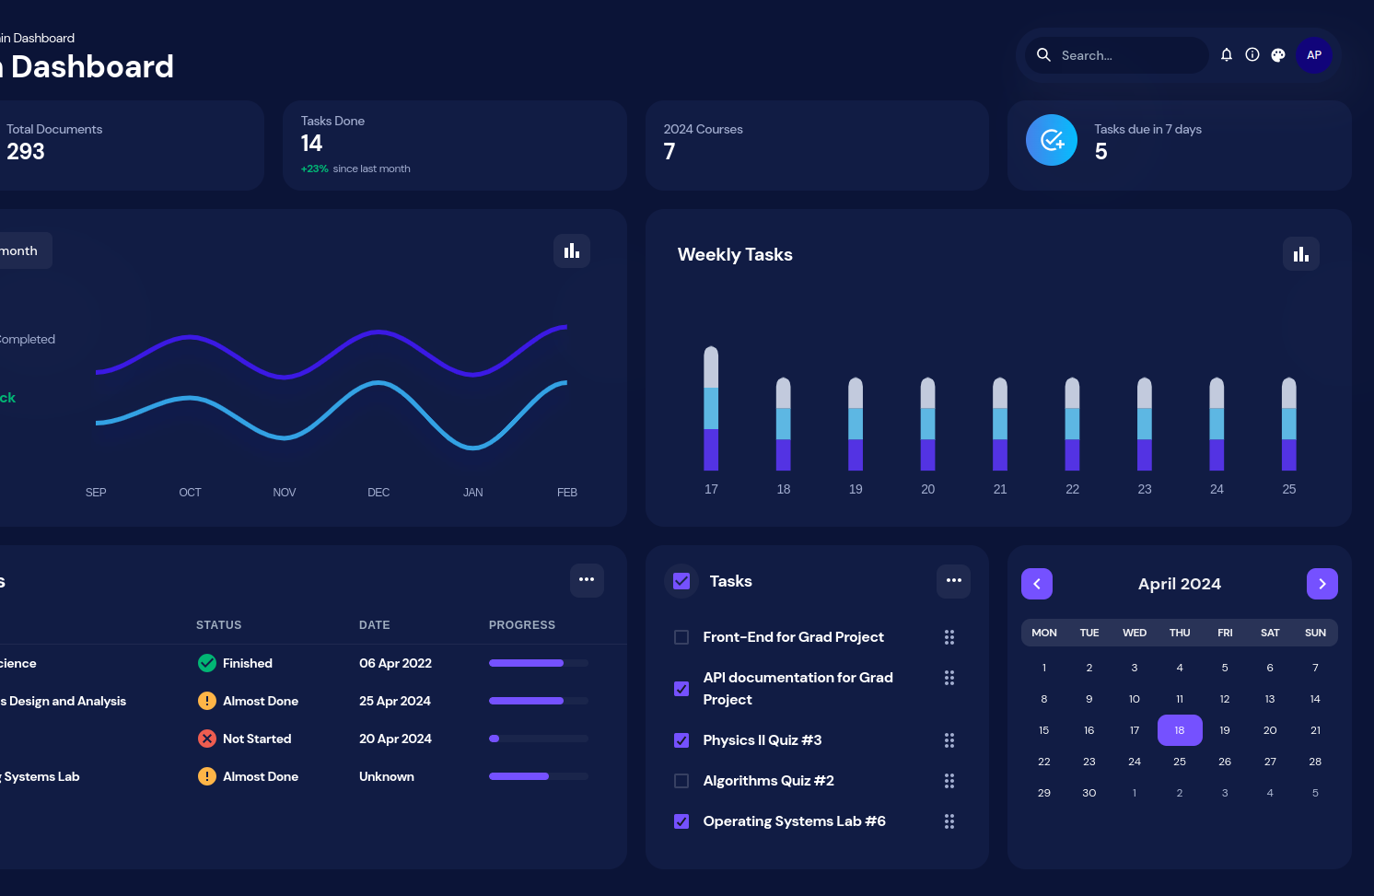
Dashboards
Dashboards for tasks, progress, and others.

Slide 15


Backend frameworks
Notes:
Talk about each one in a bit more details and how some of them are stateless

Slide 16



System Architecture Principles
Containers and Serverless Architecture
Well defined Interfaces
Operational work is minimal with low cost and high performance
Notes:
Serverless functions (not necessary a function for each thing but rather modules)
Don't communicate by sharing memory; share memory by communicating

Slide 17
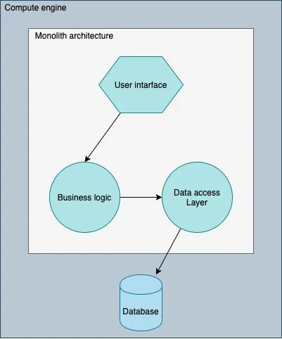
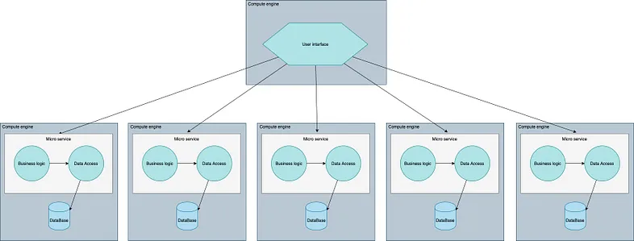
Different Architecture choices
Notes:
Some services talk to each other, some don't, other are just to compute

Slide 18
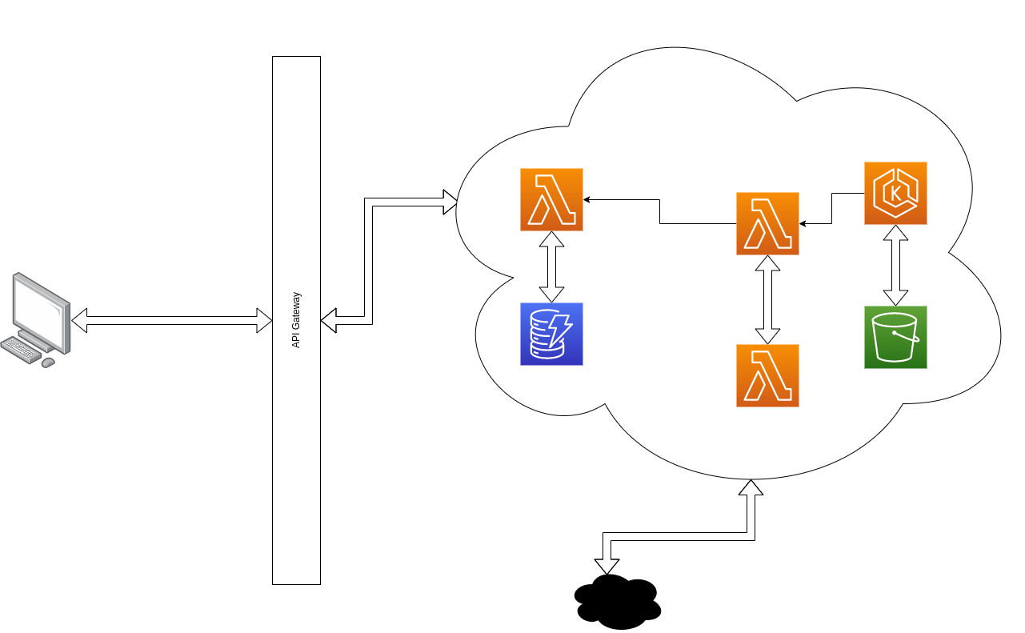
Our Implementation
Notes:
Some services talk to each other, some don't, other are just to compute

Slide 19
System Communication
00.
01.
Communication is through Interfaces (APIs and HTTPs) or Message Brokers.
Authentication and Authorization is done JWT.

Slide 20





Platform Entities (Data Models)
User
Course
Task
Resource
Notes:
Talk about each one in a bit more details and how some of them are stateless

Slide 21
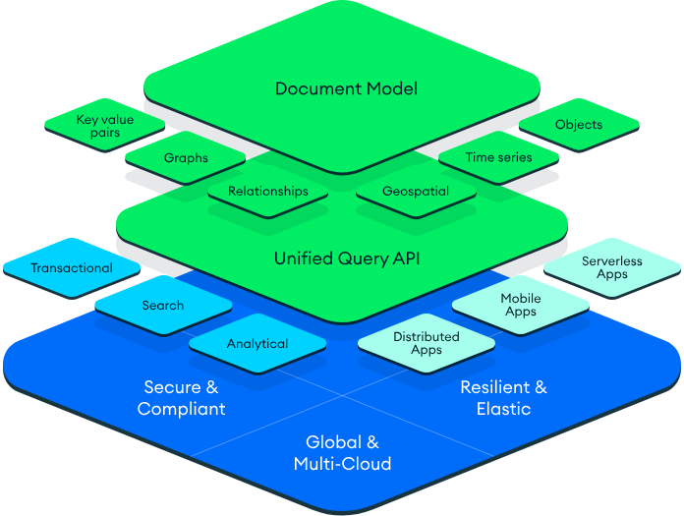
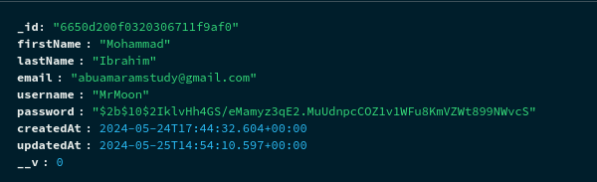
Database of Choice: MongoDB
BSON: a binary-encoded serialization of JSON-like documents
Notes:
Some services talk to each other, some don't, other are just to compute

Slide 22
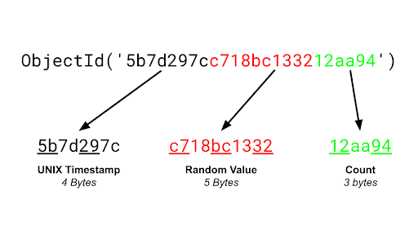
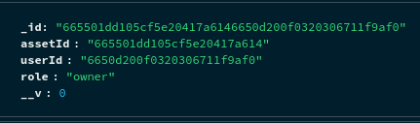
Security: Custom Generated ID for permission-based access
18,446,744,100,000,000,000
192 bits consisting of two 96 bits “ObjectId”
Notes:
Talk about why the 12 type bits are important used in Query Engine and analysis for policies

Slide 23
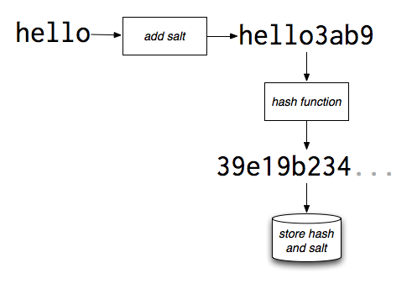
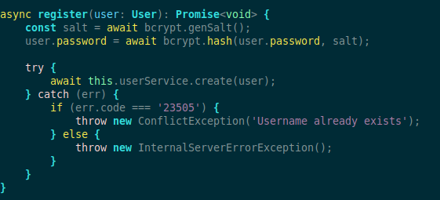
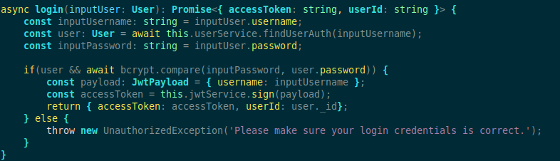
User Login
Notes:
Talk about why the 12 type bits are important used in Query Engine and analysis for policies

Slide 24
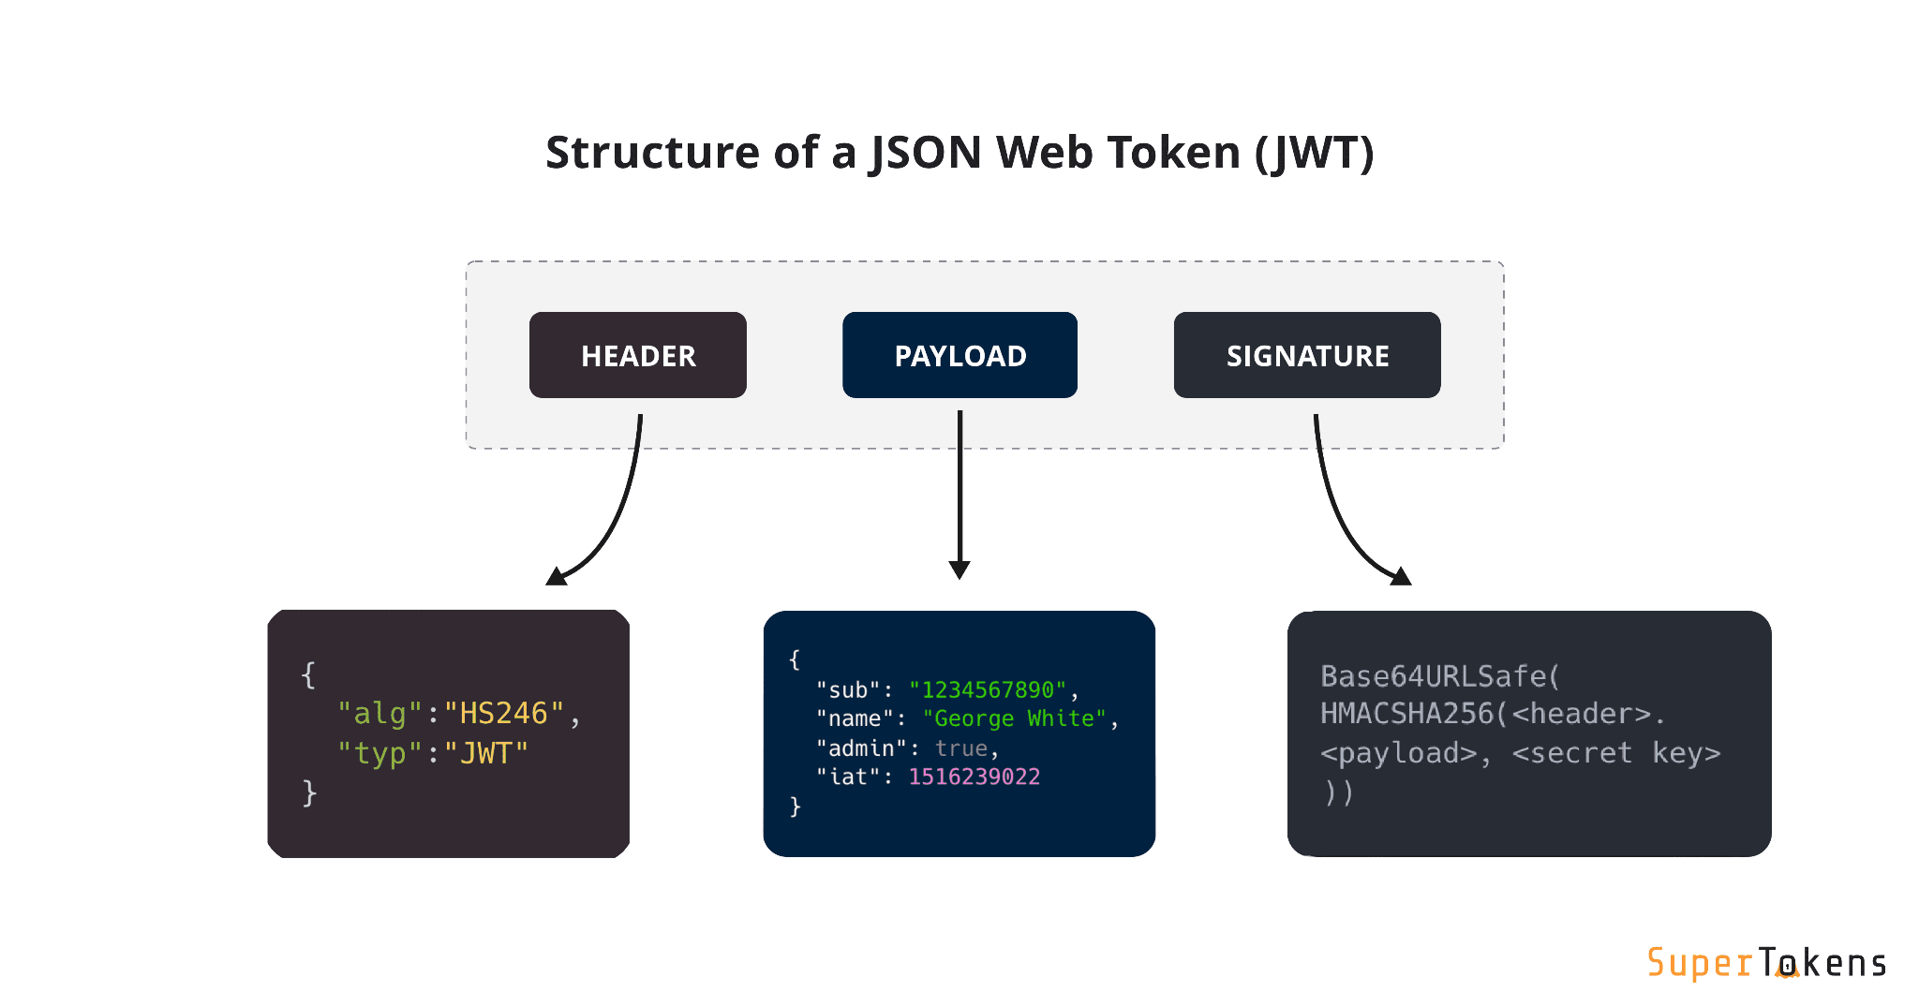
Security: JWT Token
Notes:
Talk about why the 12 type bits are important used in Query Engine and analysis for policies

Slide 25
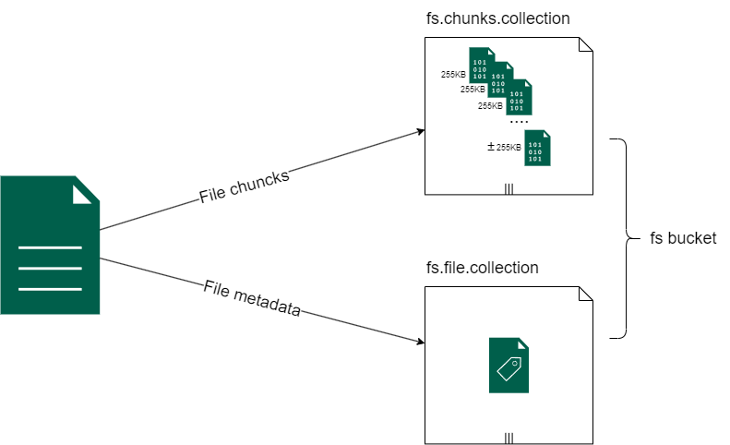
Assets and Resources
Files are splits into binary chunks (255 kB by default)
Saved as Base64 encoded BSON
Metadata includes md5, size, id of the first chunk.
Asset management is in its own service
Notes:
NoSQL databases are a good fit for microservices because they are designed to be flexible, scalable, and fault-tolerant
scale horizontally
improve the performance of microservices applications by reducing the amount of data that needs to be transferred between the application and the database

Slide 26
Testing

Slide 27
Testing
00.
01.
Frontend UI Testing
Manual Unit Testing
Notes:
Provide some examples on the overwhelming resource and platforms
HIgher education and work is a smaller gap than higher education and schools
Low investment due to lack of importance and resources
Public tooling gaps and flaws

Slide 28
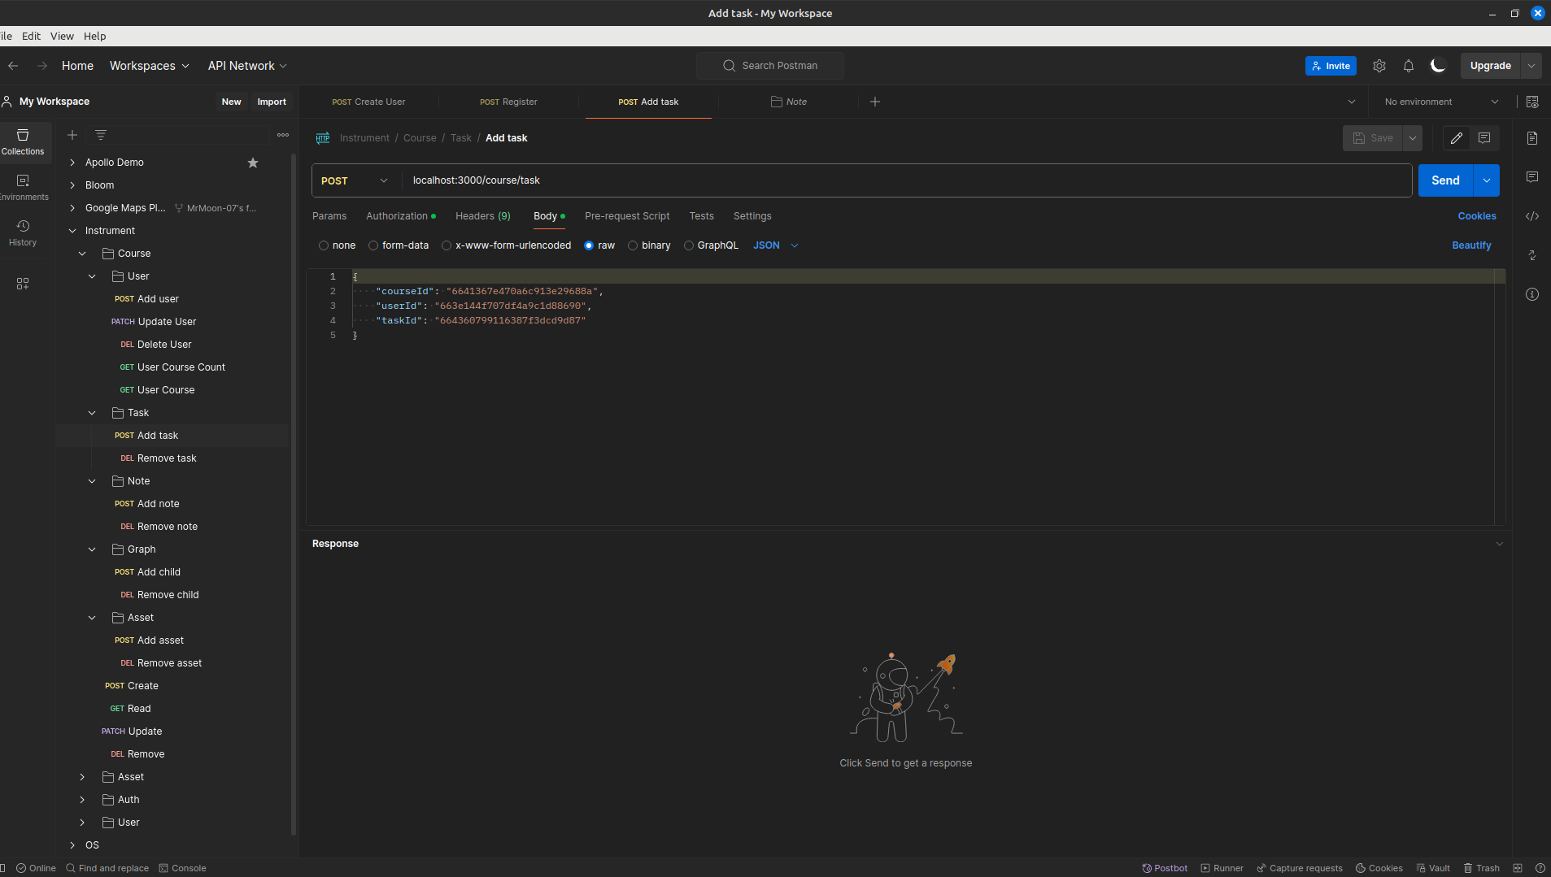

Backend Testing
Notes:
NoSQL databases are a good fit for microservices because they are designed to be flexible, scalable, and fault-tolerant
scale horizontally
improve the performance of microservices applications by reducing the amount of data that needs to be transferred between the application and the database

Slide 29
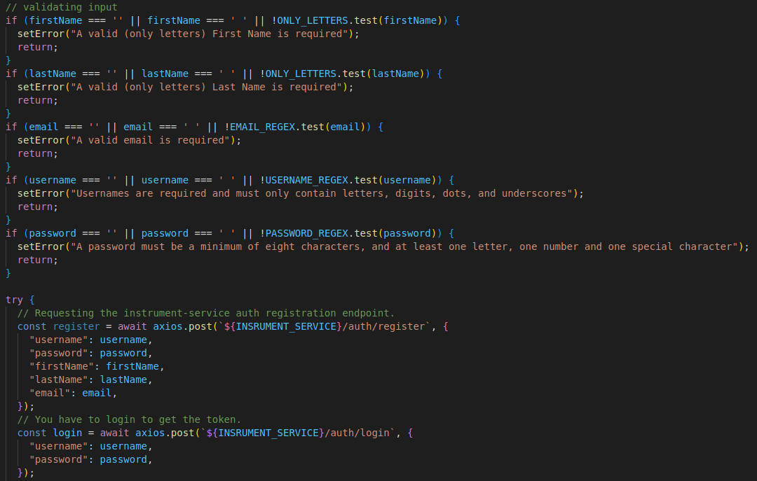

Backend Testing
Notes:
NoSQL databases are a good fit for microservices because they are designed to be flexible, scalable, and fault-tolerant
scale horizontally
improve the performance of microservices applications by reducing the amount of data that needs to be transferred between the application and the database

Slide 30
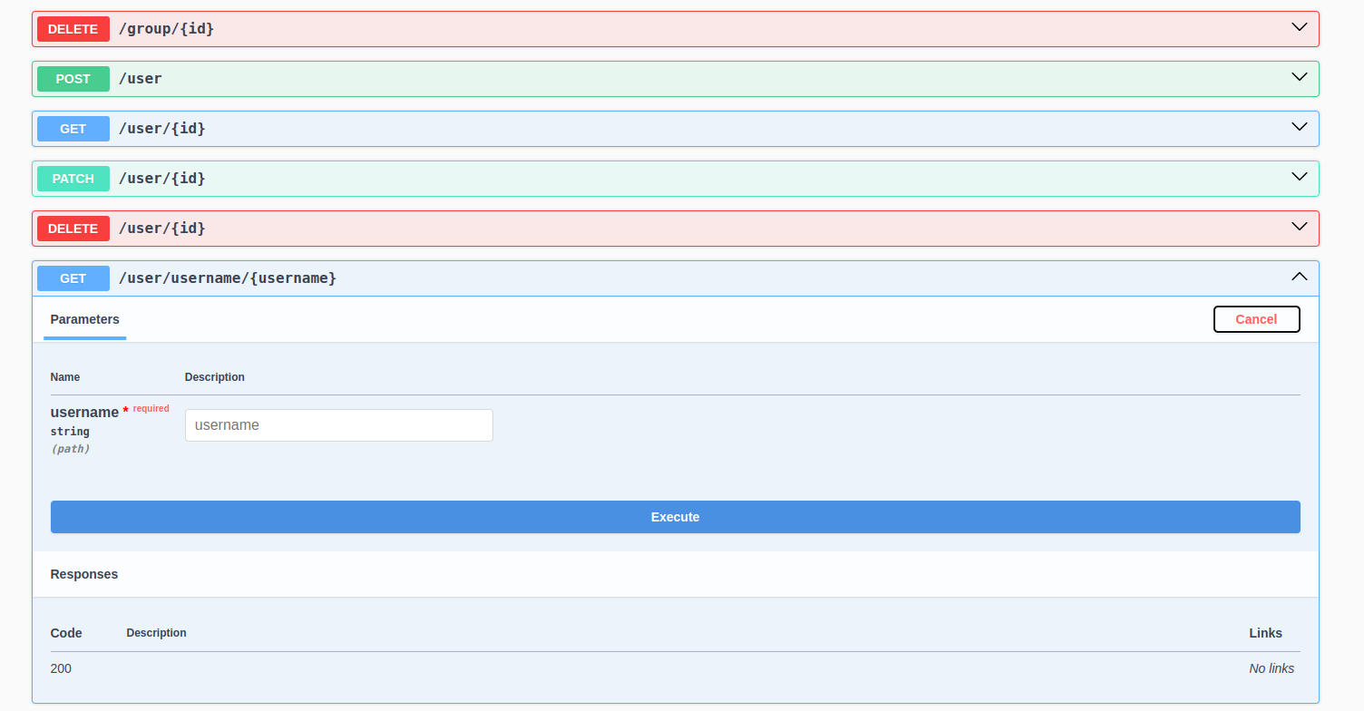

Backend Testing
Notes:
NoSQL databases are a good fit for microservices because they are designed to be flexible, scalable, and fault-tolerant
scale horizontally
improve the performance of microservices applications by reducing the amount of data that needs to be transferred between the application and the database

Slide 31
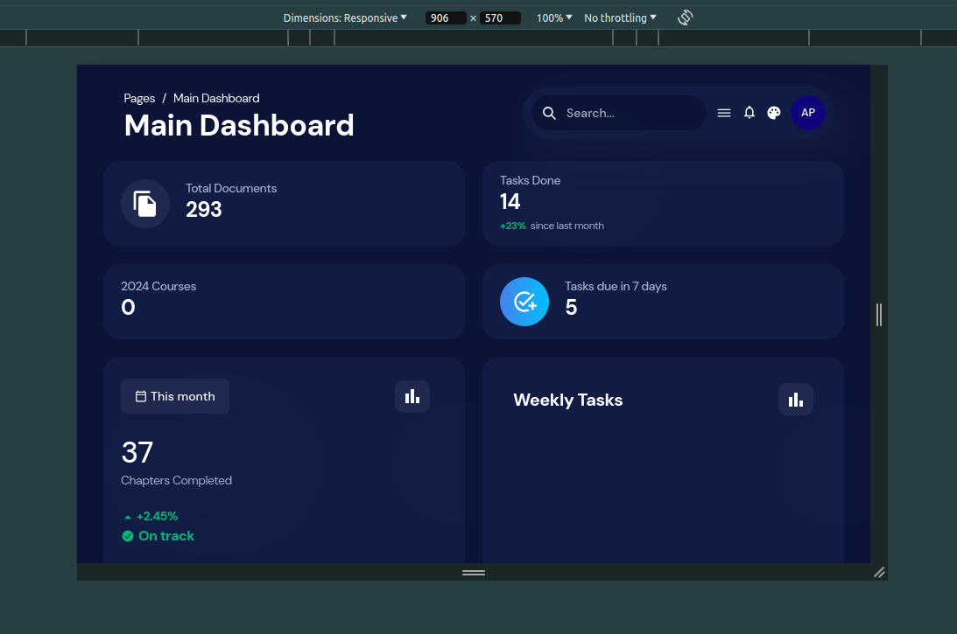

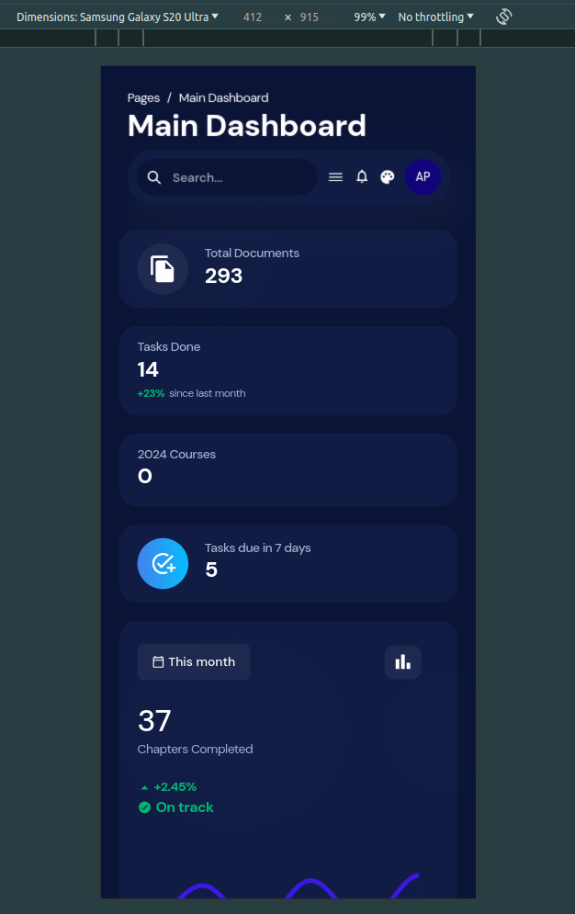
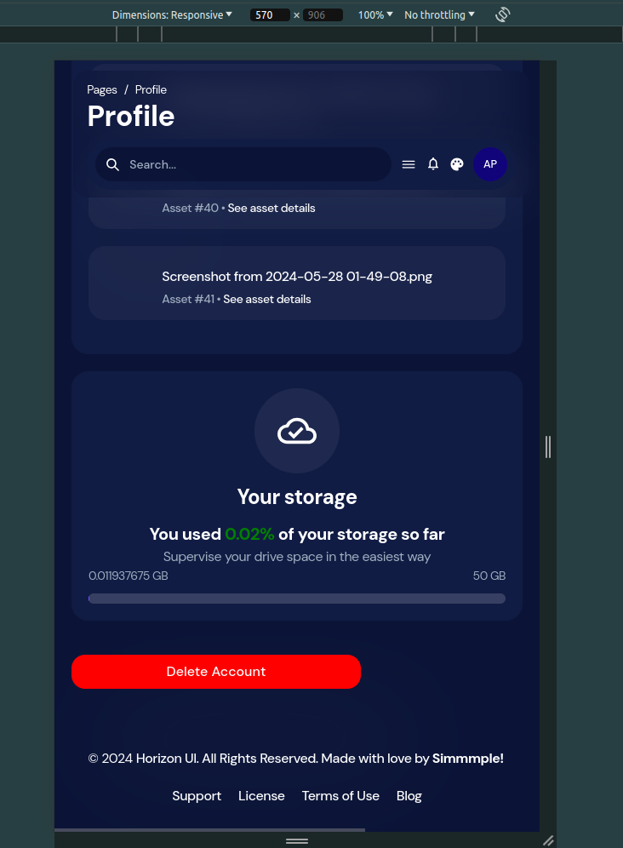
Frontend Testing
Notes:
NoSQL databases are a good fit for microservices because they are designed to be flexible, scalable, and fault-tolerant
scale horizontally
improve the performance of microservices applications by reducing the amount of data that needs to be transferred between the application and the database

Slide 32
Conclusions and Future Work

Slide 33
Future Work
00.
01.
02.
03.
Unification
Powerful Search Functionality
Supporting Student Self-assessment
Robust Security Measures

Slide 34
Others

Slide 35
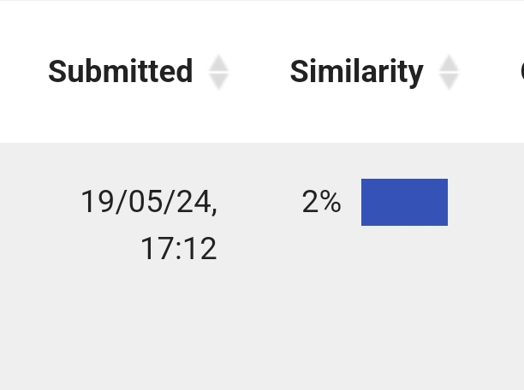
Working Stats
Wrote ~50 original pages in the documentation, more than 7000 words

Slide 36
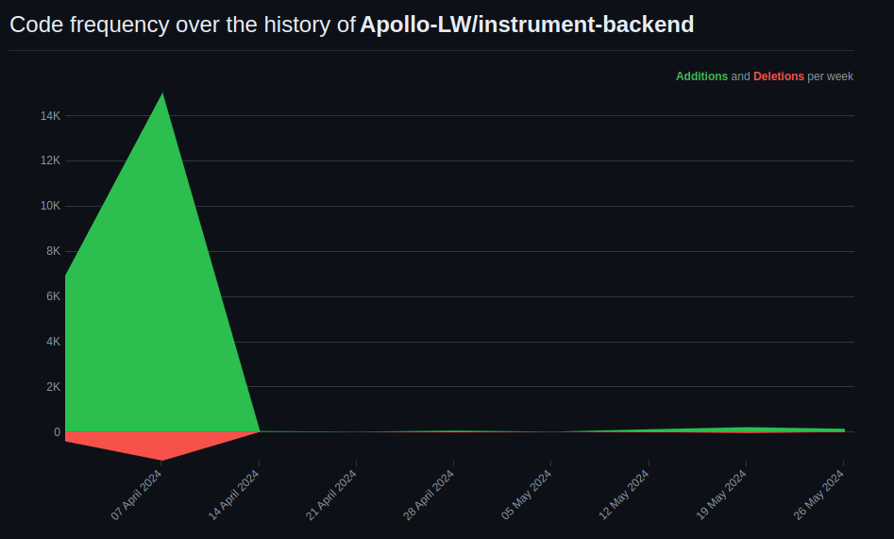
Notes:
NoSQL databases are a good fit for microservices because they are designed to be flexible, scalable, and fault-tolerant
scale horizontally
improve the performance of microservices applications by reducing the amount of data that needs to be transferred between the application and the database

Slide 37
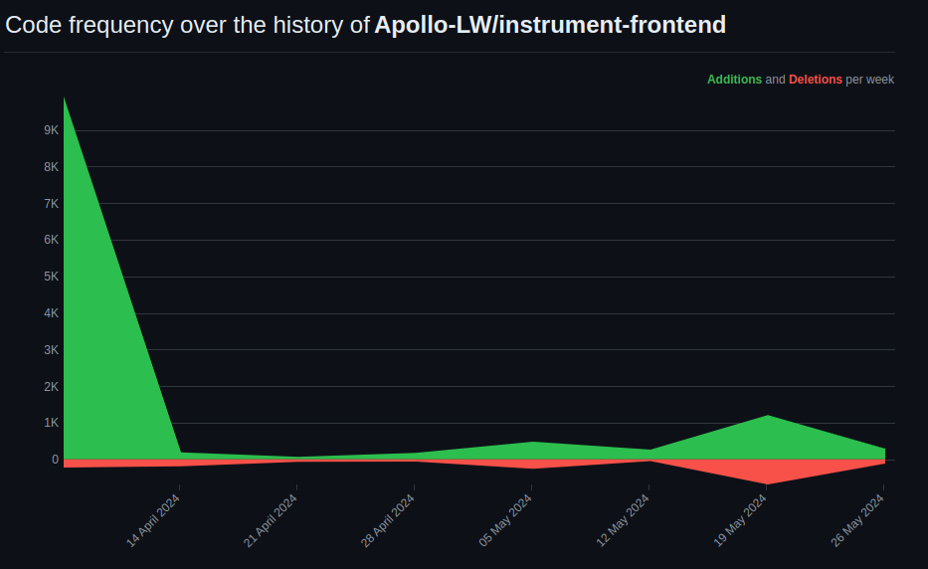
Notes:
NoSQL databases are a good fit for microservices because they are designed to be flexible, scalable, and fault-tolerant
scale horizontally
improve the performance of microservices applications by reducing the amount of data that needs to be transferred between the application and the database

Slide 38
Thanks !

Slide 39

References

